Slide 1
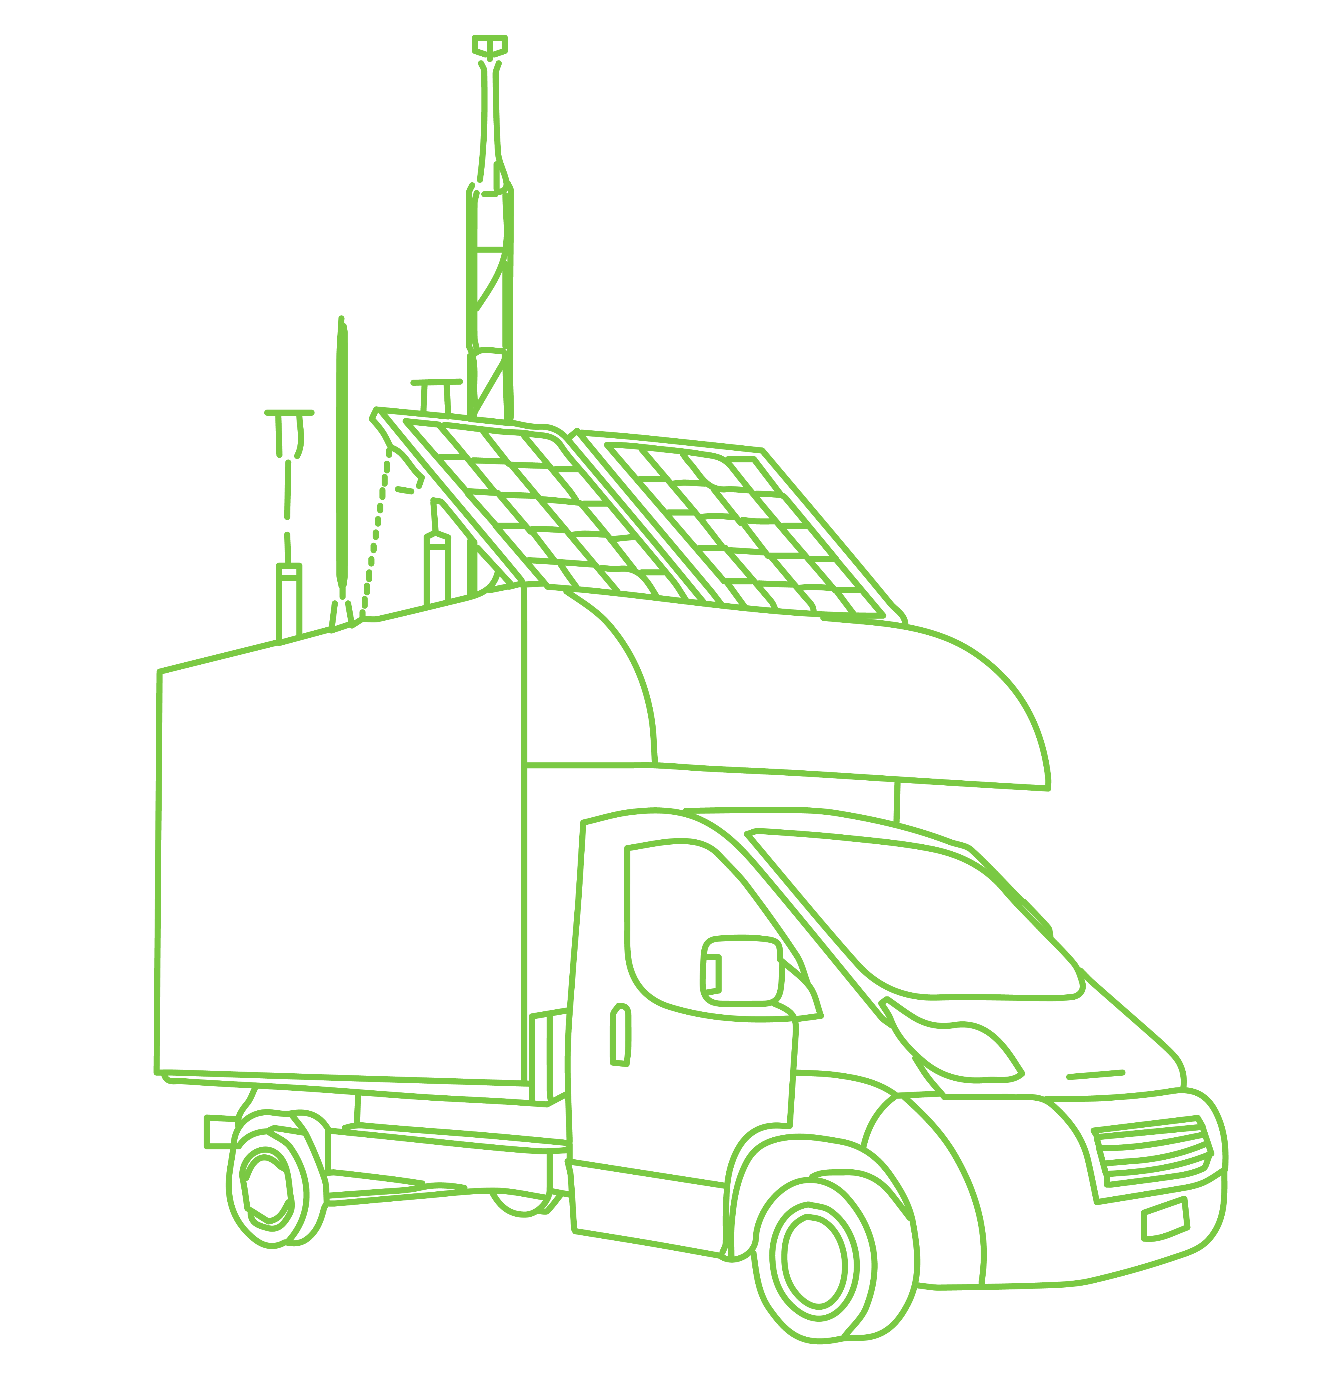
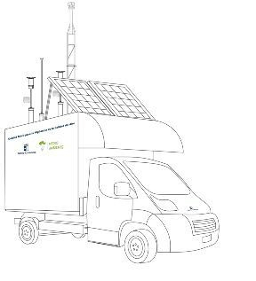
Corporate Presentation
2023
www.dnota.com
https://www.linkedin.com/company/dnota/
dnota (@dnotamedioamb) / Twitter
dnota medio ambiente - YouTube

Slide 2
Index
About dnota
Products Air Quality Monitoring Certified Equipment
Air Quality Monitoring Services Certified Equipment
Advanced IoT Products & Services Air Quality and Smart Cities

Slide 3
dnota
dnota focuses its activity on the control of pollution and environmental parameters
dnota focuses its activity on the continuous monitoring of pollution levels and air quality
dnota has been working in the traditional pollution control business for over 40 years, representing leading certified equipment manufacturers
In recent years, dnota has opted for the use of new technologies for pollution and noise control, through state-of-the-art IoT sensors.
dnota is able to offer a comprehensive service, from design engineering, assembly and commissioning of cabins and mobile units, as well as their subsequent maintenance as official technical service of most of the main brands.
We have free software for network management and visualization of air quality data, as well as the ability to connect traditional networks and state-of-the-art sensors on the platforms of all our customers.

Slide 4
Index
About dnota
Products Air Quality Monitoring Certified Equipment
Air Quality Monitoring Services Certified Equipment
Advanced IoT Products & Services Air Quality and Smart Cities

Slide 5
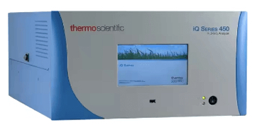
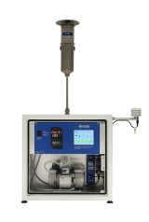
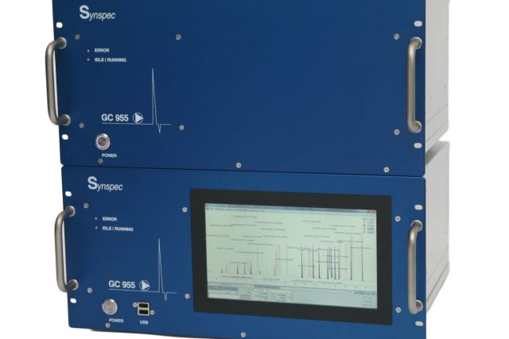
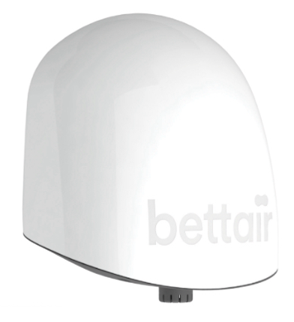
products
We are official distributors of the leading brands worldwide
dnota is an exclusive distributor in Spain. Manufacturer of equipment for air quality networks, for gases NO, NO2, NOx, NH3, SO2, CO, O3, H2S, HxC and PM10 and PM2.5 particles, emission measurement systems, for industrial safety and dilution gas calibration systems.
dnota is an exclusive distributor in Spain. Manufacturer specialized in PM10 and PM 2.5 and PM 1 particle samplers of high and low volume according to EN12341: 2014 standard in the fields of the environment, nuclear waste plants and management and precipitation captors in the form of rain or snow.
dnota is an exclusive distributor in Spain. Specialized manufacturer dedicated to the development, production and sale of gas chromatographs, in the areas of environment and industrial safety, for the measurement of BTEX hydrocarbons, ethylene oxide, butadiene, ...).
dnota is a worldwide distributor of Bettair nodes. Manufacturer of wireless air quality control nodes, IoT type. It monitors in real time gases (NO, NO2, SO2, CO, O3, H2S, VOC, NH3), particles (PM10, PM2.5, PM1), noise and other environmental parameters such as temperature, relative humidity and atmospheric pressure, and managed in an integral way through a web platform, generating graphs, reports, historical, etc.

Slide 6
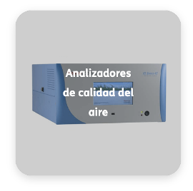
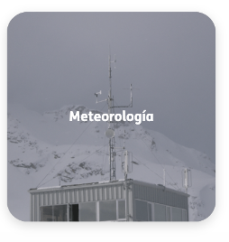
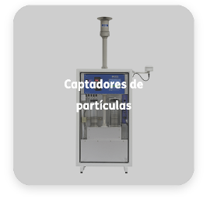
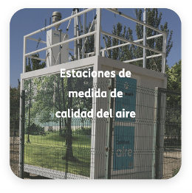
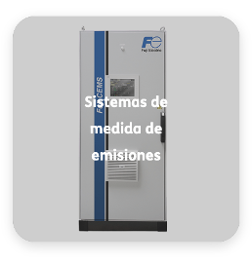
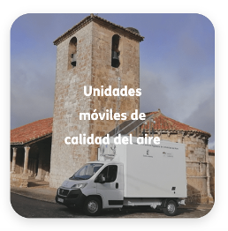
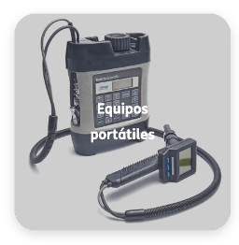
products
Air Quality Analyzers
Meteorology
Approved gas, particulate and organic compound analysers. Thermo Scientific, Synspec, Digitel, Advanced Energy and Eco Physics. and special gases INNOVA multiparametric, CH4, CO2, N2O, NH3, TCM, TCA, TCE, PCE, SF&, Ethylene oxide, etc.
Versatile, state-of-the-art weather sensors, even for extreme high mountain climates.
Air quality measurement stations
Installation of complete stations, for meteorological networks, and as part of air quality stations. 40 years with the design, manufacture, installation and commissioning of complete air quality measurement stations
Particle samplers
Digitel high (CAV) and low (CBV) volume samplers, with automatic sequential loading
Emission measurement system
Complete automatic air emissions monitoring systems Fuji, Thermo Scientific and Advanced Energy. Complete systems of automatic monitoring of emissions to the atmosphere, including Sample Conditioning Systems, isokinetic probes, gas and particle analysers, measurement of auxiliary parameters (flow, pressure, temperature, water vapor ...), calibration systems, and systems of acquisition, storage, treatment, communication and data management.
Mobile air quality units
We design and manufacture mobile air quality measurement units, adapted to customer needs. They allow automatic monitoring, with the sending of data in real time following the same standards as fixed stations, with flexibility of location, allowing specific measurement campaigns anywhere.
Bettair IoT Devices
Portable equipment
IoT sensor for Smart Cities, which provides a highly efficient and large-scale mapping tool of pollution (air and noise) of cities or industrial environments. Maintenance-free, plug & play gas sensor cartridge.
Thermo Portable Solutions for Toxic Vapours (FID or FID/PID), Hydrocarbons or Particulate Matter

Slide 7
Index
About dnota
Products Air Quality Monitoring Certified Equipment
Air Quality Monitoring Services Certified Equipment
Advanced IoT Products & Services Air Quality and Smart Cities

Slide 8
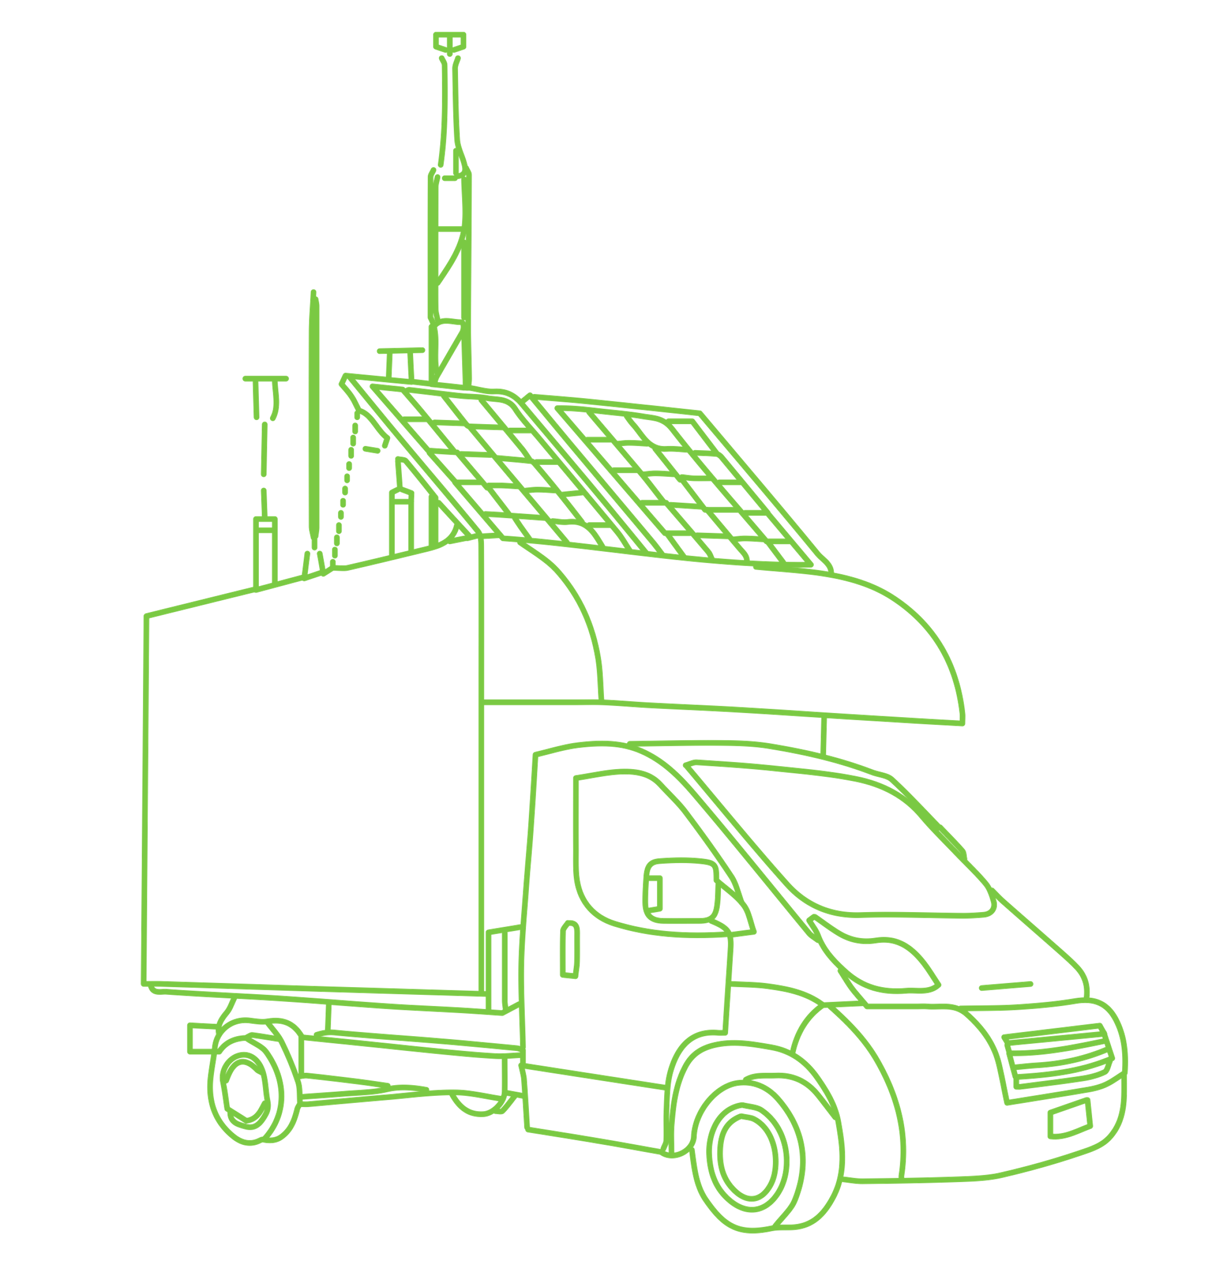
services
Turnkey projects
Network management and maintenance software
We design from complete stations for air quality networks, to mobile or portable stations. Also complex emission measurement systems, and monitoring systems for research centers. IoT sensor networks, and systems adapted to extreme weather conditions.
Open source software for data validation and maintenance management of air quality networks. Open source license that allows modification and use with unlimited duration
Planning and recording of preventive and corrective maintenance
Advanced maintenance and network management
Measurement campaigns, equipment rental and training
Highly qualified technical team with more than 40 years performing the maintenance of air quality networks, emission systems and meteorological networks, under ISO 9001 and ISO 14001 standards Comprehensive data management, from acquisition at stations, to validation and management of alerts to the population.
Official Multi-brand Technical Service of manufacturers of which we are representatives
Measurement campaigns with mobile units equipped with automatic analysers approved according to EU standards for the automatic monitoring of air quality (CO, SO2, NOx, O3, PM10, PM2.5, BTX and HC), meteorology and noise. Advice on the choice of location, installation and electrical connection, analysis and validation of data and preparation of the final report.
Rental of equipment, such as air quality gas analysers, Thermo Scientific, for measuring O3, NOx, CO2 or SO2, as well as low volume particle collectors.
Training of our gas and particulate analysers. Generic courses on the measurement of air quality, emissions, meteorology. Air quality management software training, AIRE 2.0
Calibration Laboratory is accredited by ENAC according to the UNE-EN ISO / IEC 17025 Standard for the performance of calibrations in the chemical (gas concentration) and flow (gas flow) areas.

Slide 9
Index
About dnota
Products Air Quality Monitoring Certified Equipment
Air Quality Monitoring Services Certified Equipment
Advanced IoT Products & Services Air Quality and Smart Cities

Slide 10
Smart cities
dnota is a worldwide distributor of Bettair nodes. Manufacturer of wireless air quality control nodes, IoT type. It monitors in real time gases (NO, NO2, SO2, CO, O3, H2S, VOC, NH3), particles (PM10, PM2.5, PM1), noise and other environmental parameters such as temperature, relative humidity and atmospheric pressure, and managed in an integral way through a web platform, generating graphs, reports, historical, etc.
Bettair Cities IoT devices
Sensor measurements
Particle meter (μg/m3) for:
PM1
PM2.5
PM10
Measurement of greenhouse gases:
CO2 (ppm o mg/m3)
Other environmental parameters:
VOCs
Ruido
Temperatura
Humedad
Presión
Compact wireless air quality stations, with real-time visualization web platform.
New technology for urban environments and Smart Cities layer of map efficiently and on a large scale the pollution of cities or industrial environments.
Maintenance-free and with a plug & play cartridge of gas sensors allows easy change.
Easy installation, average power consumption is minimal (2 W), and power can be done by cable connection to the network, or by a small solar panel
Static nodes are composed of electrochemical gas sensors (up to 6 sensors) to measure (ppb or μg/m3):
NO2
NO
CO
O3
SO2
H2S
NH3
Certificate SGS
Independent evaluation report
Certificado Cambridge UK Independent evaluation report
Polutants NO, NO2, O3, PM2.5 y PM10
Intercomparision with reference methods
Correlation with reference stations
Pollutants CO, NO, NO2, O3, PM1, PM2.5 y PM10, Temperature and Humidity
Intercomparision with reference methods Very good result

Slide 11
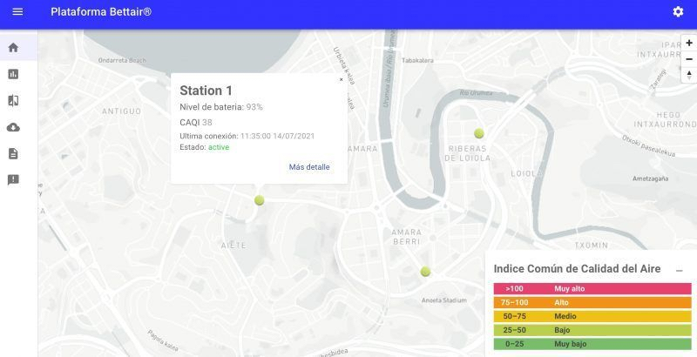
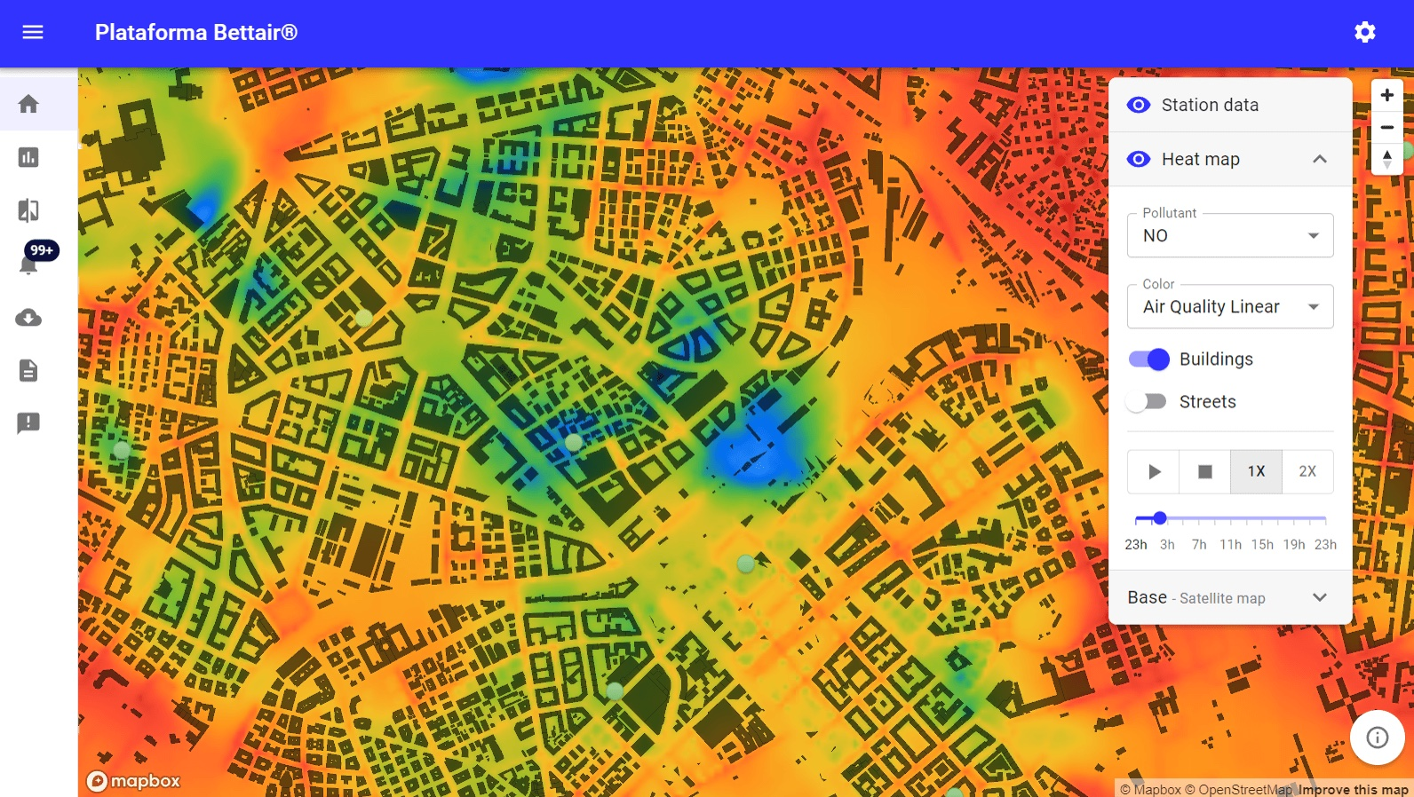
Smart cities
Real-time data visualization
The data visualization is geolocated and allows, by username and password, to see in real time the information of all its nodes: on a map, customizable graphs by parameters, automatic generation of reports, download of historical data, etc.
Air Quality Mapping (bAQM) "The tool that any city dreams of having”
The limit values for NO2, O3, NO and particulate matter on air quality are systematically exceeded in many cities. This service makes it possible to quantify and understand citizens' exposure to pollutants, assess the impact of measures to improve air quality and improve their planning. All this is possible thanks to accurate air quality predictions
The bettair model takes into account urban canyons using an Artificial Intelligence (AI) module for Computational Fluid Dynamics (CFD) simulations. This module has been developed in collaboration with the Barcelona Supercomputing Center (BSC) and awarded the HPC Innovation Excellence Award from the prestigious Hyperion Research.
Carry out specific or periodic air quality measurement campaigns?
Rental or Renting or sale of data?
We offer a service of carrying out air monitoring campaigns wherever you need it, through a rental of IoT equipment.
Option of feeding with solar panels and there is the possibility of choosing the number, duration and location of the sampling points. Change them whenever you want. The installation will be done by our technicians, or yourself, in a simple way. You'll be able to access and download real-time data, view graphs, set up custom alerts, and more.
If you don't want to buy IoT equipment to measure air quality, no problem, ! We rent them or sell the data !
For as long as you need, you can connect them yourself, wherever you want, whenever you want. Also available renting of IoT nodes for 12, 18 or 24 months. You put them wherever you want, turn them on and voila! We also provide data for as long as you need

Slide 12
For a higher quality air
Do we walk the road together?
www.dnota.com
https://www.linkedin.com/company/dnota/
dnota (@dnotamedioamb) / Twitter
dnota medio ambiente - YouTube

Slide 13
Thank you

